Slide 1
HIMS-AI-2526
AI Powered Hospital
Information Management System
Team Members:
Ali Akbar (BSCS51F22R036)
Muhammad Najee Ullah Noon (BSCS51F22S043)
Supervisor: Mr. Aamir Zia
Manager: Dr. Muhammad Ilyas
Submission Date: 09-05-2026
Department of Computer Science — Capstone Project

Slide 2
Presentation Agenda
01
Introduction & Project Overview
06
Implementation & Technology Stack
02
System Description & User Roles
07
System Architecture & Modules
03
Functional Requirements
08
Design Documents & Diagrams
04
Non-Functional Requirements
09
UI Interfaces & Dashboards
05
Use Cases
10
Testing & References

Slide 3
Project Overview
⚠ Problem
Hospitals face manual data entry, fragmented records, and administrative overload — leading to delays and errors in patient care.
🎙
👨‍💻
✅
📊
AI Recording
NLP Extraction
Doctor Verification
Smart Dashboards
Real-time doctor-patient conversation capture & transcription
GPT-based extraction of symptoms, diagnosis & medications
Doctors review AI notes before they are saved to the database
Role-based dashboards for Doctors, Admin, Receptionists & Patients

Slide 4
Project Scope — Inclusions & Exclusions
✔ AI-assisted medical note creation from doctor-patient conversations
✔ Smart appointment & real-time queue management
✔ Controlled patient self-registration (staff-verified activation)
✔ Centralized patient record & prescription management
✔ Integrated staff dashboards for all user roles
✔ Secure messaging, billing, and downloadable reports
✔ Healthcare analytics and operational insights
✘ No autonomous disease diagnosis without doctor approval
✘ No cross-hospital automatic data transfer
✘ No payroll or pharmacy stock management
✘ No emergency dispatch or ambulance coordination
✘ No predictive disease analytics in current version
✘ Language limited to English, Urdu, and Punjabi

Slide 5
User Roles & Characteristics
Doctor
Receptionist
👨‍⚕️
Primary user. Manages consultations, reviews AI-generated SOAP notes, confirms and stores medical records. Requires minimal interface interruption.
📋
Assigned to one doctor. Handles patient registration, appointment scheduling, queue management, and check-ins.
Admin
Patient
🏥
Manages user accounts, monitors data flow, generates analytical reports, and ensures system compliance and security.
🙍🏻‍♂️
Tertiary user. Accesses visit history, prescriptions, and reports through patient portal. Staff can assist non-technical patients.

Slide 6
Doctor Consultation Session Flow
1
2
3
4
5
Start Session
Record Conversation
AI Processing
Review SOAP Notes
Submit & Store
Opens fullscreen session modal; loads patient history & SOAP template; requests mic permission
Audio captured in real time; 'Recording…' pulse indicator; stop to save audio blob
Deepgram converts audio to text; Open AI GPT 4.1 extracts symptoms, diagnosis, medications
AI-generated summary displayed; doctor can edit fields; unsaved changes are highlighted
SOAP notes + audio uploaded; appointment marked 'Completed'; records saved to PostgreSQL

Slide 7
Operating Environment & System Constraints
Web-Based Platform
Software Constraint
Accessible via Chrome, Edge, Firefox on desktop or mobile devices.
Depends on Deegram & OPENAI GPT 4.1; service interruptions affect accuracy.
Cloud Hosting
Language Constraint
Secure cloud infrastructure for high availability, backups, and scalability.
Supports English & Urdu only. Accents/dialects may reduce accuracy.
Hardware Needs
Privacy & Legal
Min. 8 GB RAM, stable internet. Django backend + ReactJS frontend.
HIPAA-equivalent compliance required. Consent needed for recordings.
Database & APIs
Environmental
PostgreSQL for data. REST APIs for AI, NLP, and auth integration.
Background noise in busy hospitals can reduce transcription accuracy.

Slide 8
Functional Requirements
FR-01
Patient Registration
FR-02
Appointment Scheduling
Staff-verified registration with unique hospital ID assignment
First-come-first-serve booking with real-time queue tracking
FR-03
Electronic Medical Records
FR-04
Billing & Payment
Secure, centralized storage of diagnoses & treatment histories
Auto-generated bills; JazzCash / Easypaisa online payment support
FR-05
Role-Based Auth
FR-06
Analytics & Reports
Secure login with RBAC for Admin, Doctor, Receptionist, Patient
Graphical dashboards; PDF export of hospital analytics
FR-07
Notifications & Alerts
FR-08
Backup & Recovery
Appointment reminders, billing alerts via dashboard notifications
Scheduled automated backups; admin-triggered data restoration

Slide 9
Non-Functional Requirements
Performance
Security
Patient records retrieved in < 20 sec
Appointments scheduled in < 5 sec
Supports 100 concurrent users
UI loads in < 6 sec on hospital network
Role-Based Access Control (RBAC)
SSL/TLS encryption at rest & in transit
Audit logs of all user activities
Session timeout for inactive users
Safety
Documentation
Prevent unauthorized modification of records
Daily automatic data backups
Auto-recovery on server crash / power outage
Warning messages for invalid operations
User manual for all roles
Admin guide for config & maintenance
Troubleshooting guide
In-system help tooltips & FAQs

Slide 10
Use Cases Overview
UC-21
AI-Assisted Medical Documentation
Doctor starts session → AI captures conversation → NLP extracts key info → Doctor reviews & confirms → Records saved to database
Actor(s): Doctors
UC-22
Appointment & Queue Management
Patient requests appointment → Receptionist confirms → Queue position assigned → Real-time queue updates displayed
Actor(s): Patients, Receptionists
UC-23
Patient Record Access
User logs in → Searches patient → Views history, prescriptions, reports → Can download PDF reports
Actor(s): Doctors, Patients, Receptionists
UC-24
Prescription Management
Doctor creates/updates prescription → Stored in database → Patient accesses digital prescription via portal
Actor(s): Doctors, Patients
UC-25
Secure Communication
Users send healthcare messages → System delivers securely → Dashboard alerts for appointments & billing
Actor(s): All User Roles

Slide 11
Technology Stack
Frontend
ReactJS | HTML5 | CSS3 | Tailwind CSS
Backend
Django (Python) | Django REST Framework | Cookie-Based Auth
Database & Storage
PostgreSQL | Cloud / Local Storage | PDF Export
AI & Voice
Deepgram| OPEN AI GPT 4.1|
DevOps & Tools
Git / GitHub

Slide 12
System Architecture Overview
• ReactJS frontend provides role-based dashboards communicating via REST APIs
• ReactJS frontend provides role-based dashboards communicating via REST APIs
• Django backend handles business logic, RBAC, AI documentation, and DB operations
Users
(Browser)
ReactJS
Frontend
Django
Backend
+ DRF APIs
PostgreSQL
Database
• Django backend handles business logic, RBAC, AI documentation, and DB operations
• PostgreSQL stores all patient records, appointments, prescriptions, and logs
• PostgreSQL stores all patient records, appointments, prescriptions, and logs
• AI / Voice modules process speech-to-text and NLP for structured medical notes
• AI / Voice modules process speech-to-text and NLP for structured medical notes
AI / Voice
Services
• External SMTP / email APIs support notifications and appointment alerts
• External SMTP / email APIs support notifications and appointment alerts

Slide 13
Key Module Implementations
AI Consultation & Documentation
Communication & Notification
Voice capture → Deepgram→ Open AI GPT → SOAP note generation → Doctor confirmation → PostgreSQL storage
Secure healthcare messaging; appointment reminders and billing alerts via dashboard and email
Appointment & Queue Management
Administrative Dashboard
Patients book online → System assigns FCFS queue position → Real-time status updates via dashboard
User management, doctor-receptionist assignments, analytics dashboards, billing, and activity monitoring
Patient Record & Prescription
Authentication & RBAC
Centralized records with prescription history; downloadable PDF reports for patients and doctors
Role-based access control for Admin, Doctor, Receptionist, Patient; cookie-based session management

Slide 14
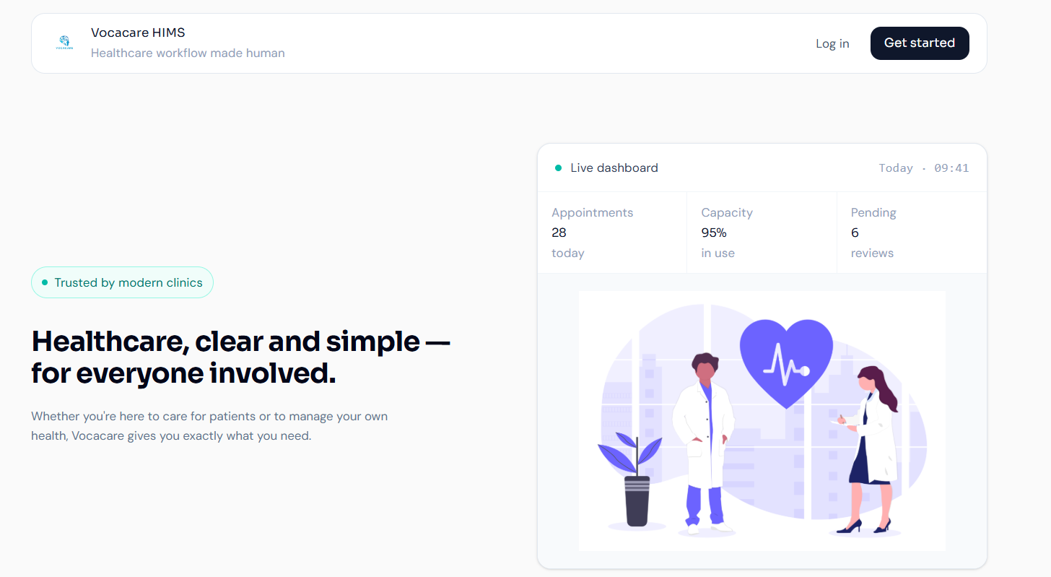
UI Interfaces — Dashboards
Landing Page

Slide 15
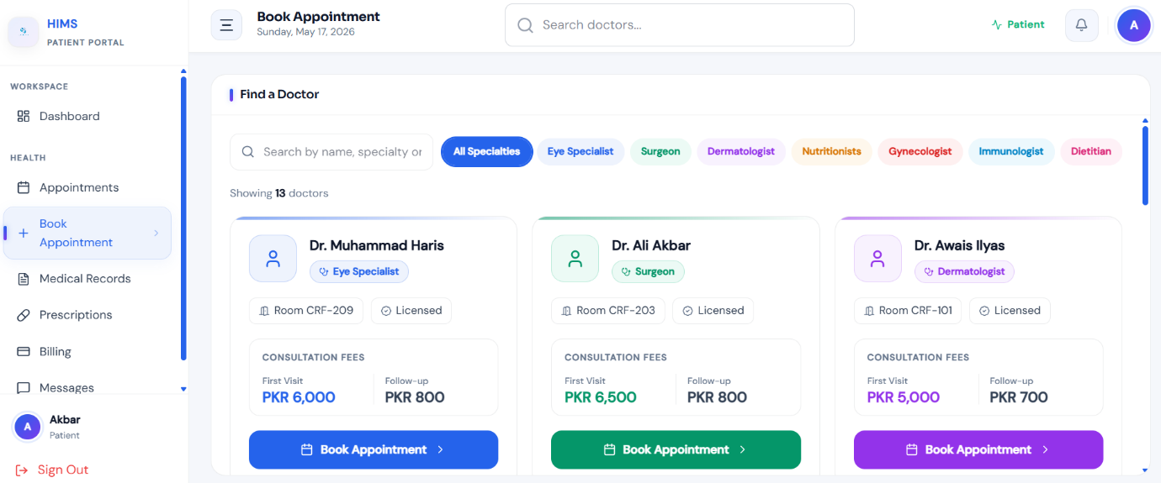
UI Interfaces — Dashboards
Patient Dashboard

Slide 16
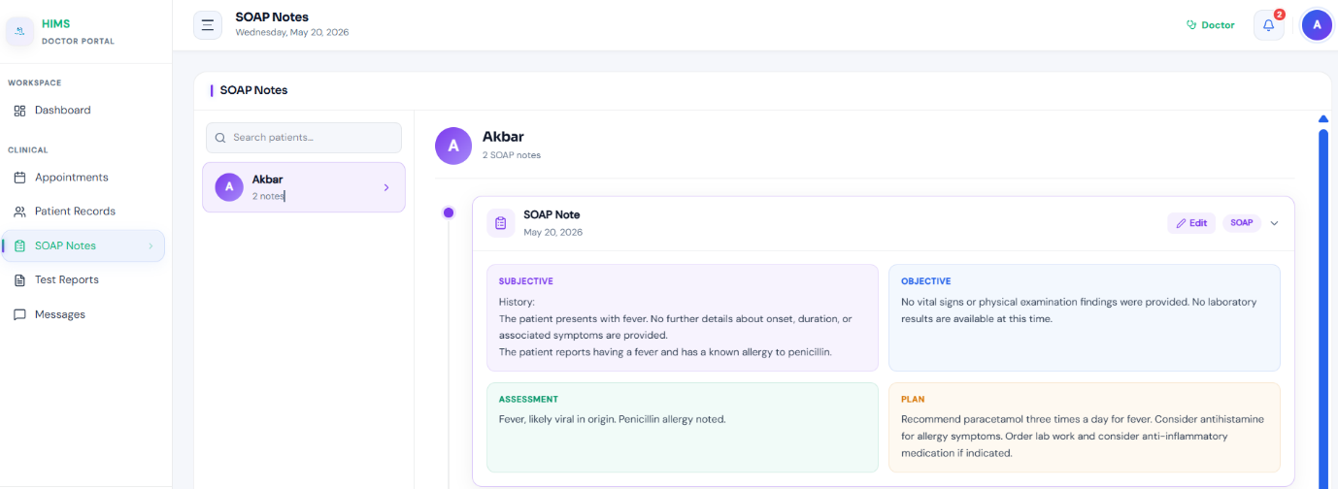
UI Interfaces — Dashboards
Doctor Dashboard

Slide 17
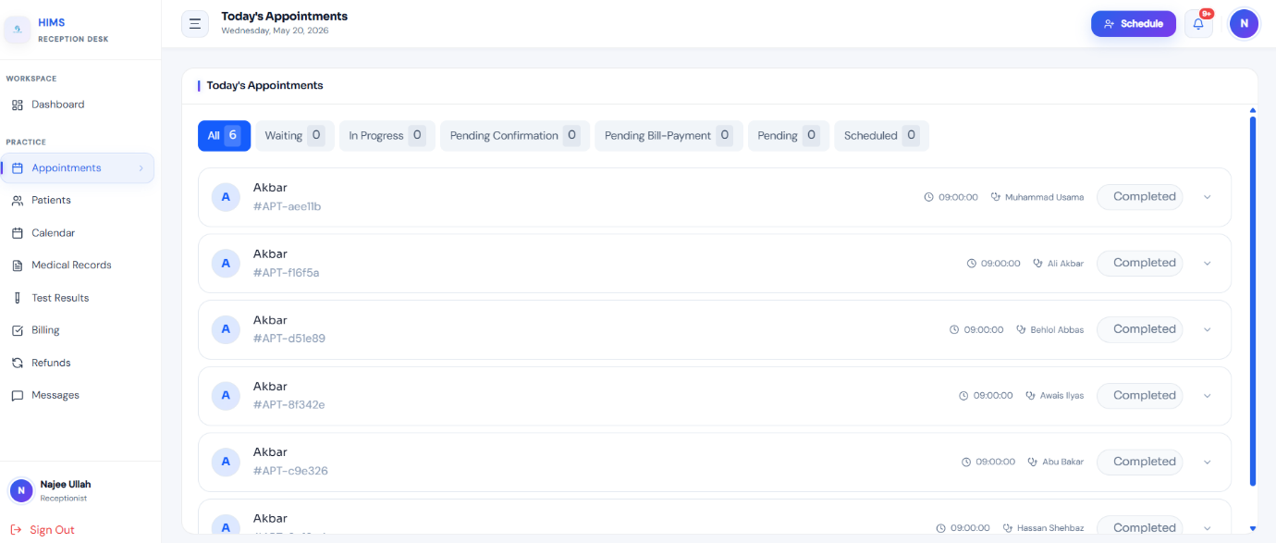
UI Interfaces — Dashboards
Receptionist Dashboard

Slide 18
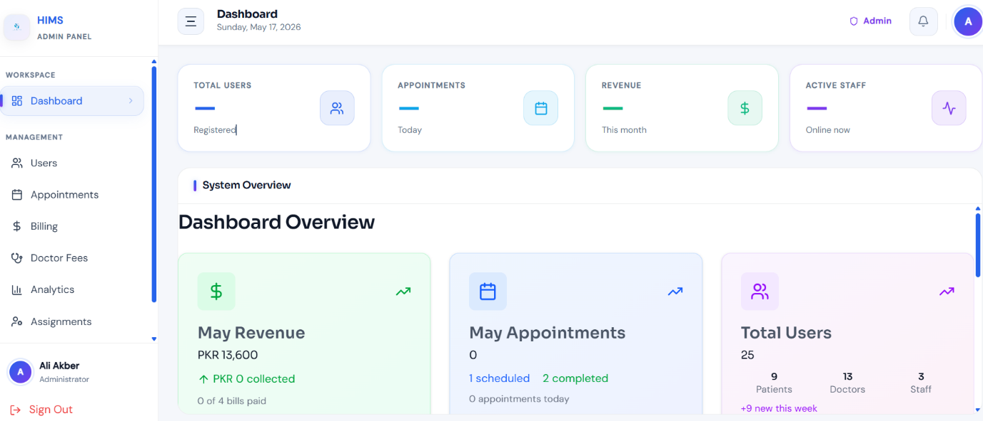
UI Interfaces — Dashboards
Admin Dashboard

Slide 19
Functionality & Performance Testing
Functional Testing
Performance Testing
Security Testing
Patient registration, login, role access verified
Appointment booking and real-time queue updates
AI recording → transcription → SOAP note → storage
Prescription creation, access, and PDF download
Record retrieval < 20 sec under load testing
100 concurrent users simulated — no degradation
UI load time < 6 sec on standard network
Report generation for 5,000 records < 7 sec
RBAC: unauthorized access blocked and logged
Encryption verified for data at rest and in transit
Session timeout enforced for inactive users
SQL injection and XSS protection tested

Slide 20
Conclusion & Impact
🎙 AI-Driven Documentation
🏥 Operational Efficiency
Eliminates manual data entry; SOAP notes generated automatically from doctor-patient conversations.
Real-time queue management and centralized records reduce waiting times and administrative load.
🔒 Secure & Compliant
📈 Scalable Architecture
RBAC, SSL/TLS encryption, audit logs, and HIPAA-equivalent compliance protect patient data.
Modular design supports future AI enhancements and integration with additional hospital systems.
"Transforming conversations into care."

Slide 21
Thank You

